Slide 1
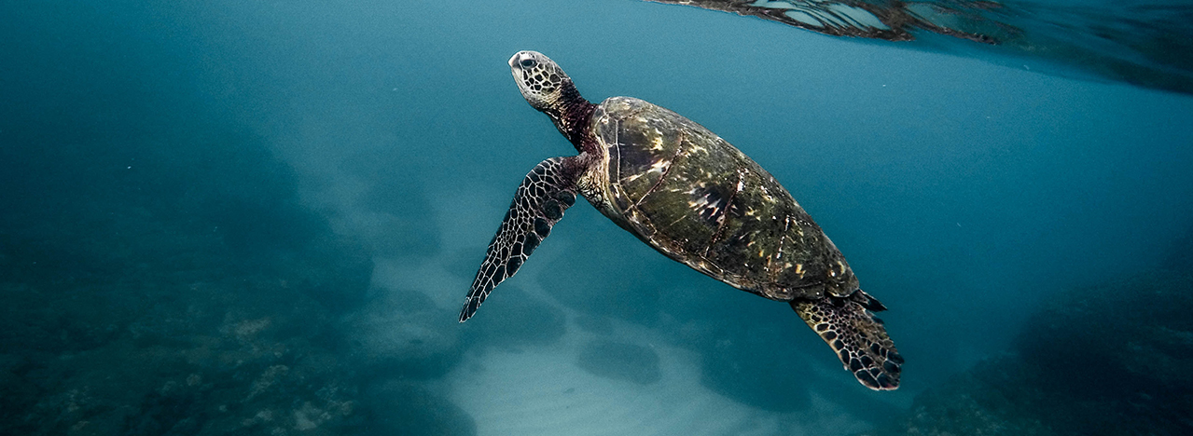
Predicting Future Ocean pH
Danielle Lamb
Bellevue University
DSC630

Slide 2

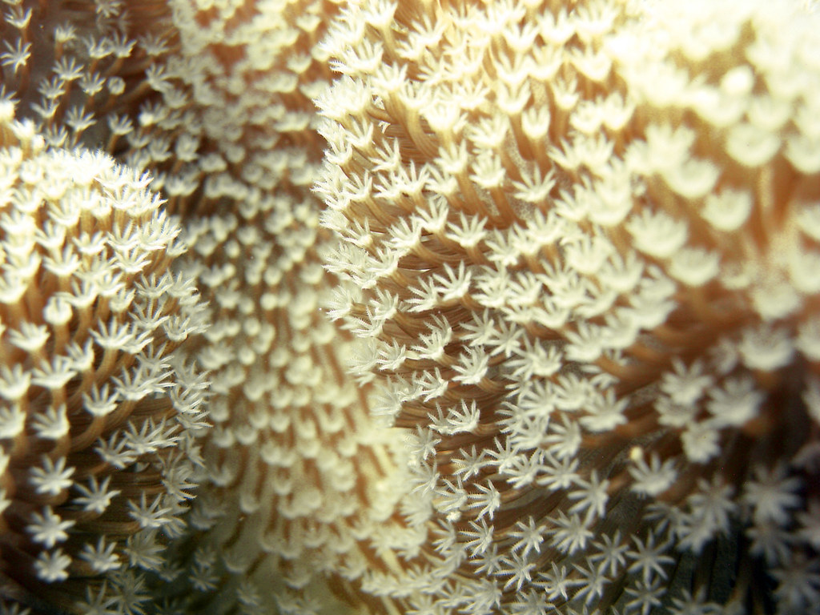
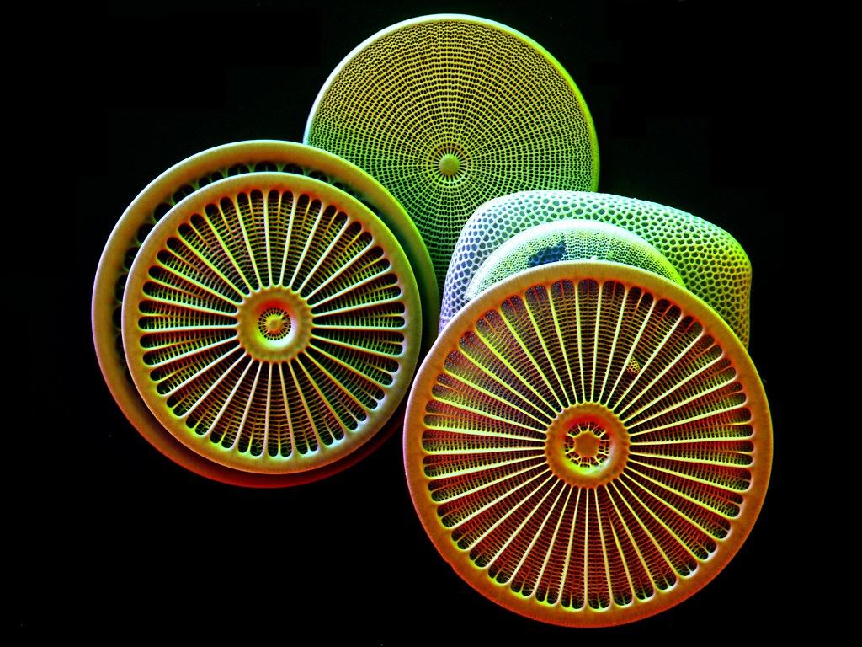

Problem
To continue to produce oxygen, corals require a steady and slightly alkaline pH (around 8). If not, the coral can become stressed and expels the organisms that live inside them that produce oxygen.
Coral Symbiosis
The trend of ocean pH is decreasing more rapidly since the beginning of the industrial revolution. There are 2 main issues with decreasing pH
Phytoplankton
To be able to grow and thrive, phytoplankton need a alkaline pH. Their bodies are made of calcium carbonate, which dissolves in acidic water. They produce oxygen through photosynthesis and cannot if their bodies are dissolved away.
2
Notes:
The trend of ocean pH is decreasing more rapidly since the beginning of the industrial revolution. Before this time the pH of the ocean stayed within 0.1 of itself for hundreds of years. Beginning at the start of the industrial revolution with the increase use of mechanical processes that emit carbon dioxide more of these emissions are being inputed into the atmosphere. When the atmosphere mixes with ocean waves the carbon dioxide is incorporated into the ocean water. With the increase of the concentration of carbon dioxide in the ocean water the result is a decreasing pH. This is a problem for numerous reasons as a decreasing pH means the ocean water is becoming more acidic. As anything becomes more acidic it has a greater capacity to dissolve carbon which is the basis of all life on earth. Both coral and phytoplankton use carbon as a part of their bodies. With the inclusion of calcium to create calcium carbonate these organisms are able to create hard bodies that protect them from external threats. The symbiotic relationship between coral and a microorganism call zooxanthellae is able to produce oxygen by photosynthesis. The same can be said for phytoplankton which are microorganisms that live near the surface of the ocean. If the water becomes more acidic following the current trend both the coral and phytoplankton will no longer be able to create the calcium carbonate shells. As a result we are currently seeing bleached coral reefs which indicate that the coral is no longer habitable by the photosynthetic microorganisms. We can also hypothesize a decrease in population of phytoplankton. Both corals and phytoplankton Produce approximately 70% of the world's oxygen. Without them we can assume there would be a significant decrease of oxygen within the air that we breathe. Finding a solution to the rapid decrease in pH is crucial to maintain the appropriate proportion of oxygen that is required for both animals in the ocean as well as on land, including us.

Slide 3

Target Audience
Ocean Agencies
Those who devote their lives to the research of the oceans
Those who educate about the need for healthy oceans
Big Companies
Travelers, Ocean-goers
Overall Ocean Health
Those who introduce the most carbon dioxide into atmosphere
Those that can create the most dramatic change in carbon emissions
Those that make a livelihood by fishing and business on the ocean
Those who vacation and enjoy snorkeling or diving on reefs.
3
Notes:
Overall ocean health should be a priority for everyone however those groups who can heavily benefit from this project include big companies ocean agencies and travelers. Big companies create the majority of carbon emissions that humans are in putting into the atmosphere. Through different processes such as creation of goods shipping in running buildings input a significant amount of carbon dioxide into the atmosphere. Creating model that can predict future pH and the change in trend would allow them to understand the urgency of them choosing greener and cleaner energy options. Ocean agencies have been researching the ocean Anne will continue to research the ocean. Having an accurate prediction model for PH will allow them to continue research in actions for assisting organisms with adapting to lower pH. Current research is being done with coral to selectively breed coral that are more Hardy an able 2 survive with significant changes NPH. If the current trends of pH are not changed this research is crucial in the continued survival of coral reefs in the world's ocean as a whole. Without this those reefs most likely would die an as an ecosystem there will be a snowball effect of possible extinctions of ocean creatures since the coral reefs no longer would be able to provide structure safety food Anna community. Travelers and those who live by the ocean both enjoy what the ocean has to offer. This includes coral reefs to scuba and snorkel as well as a monetary source for those who fish on these reefs. While all three audiences have significantly different additions 2 ocean health all are necessary to create a healthy ocean.

Slide 4
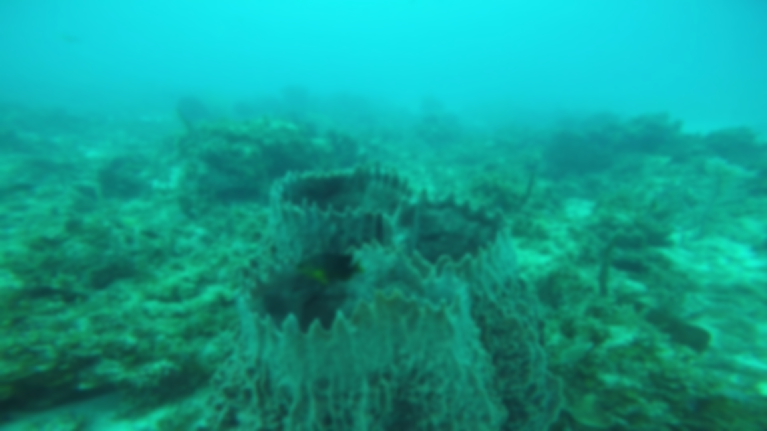
Solution
Having more data to be able to educate adults and children alike on ocean health and the impacts that it can have on the world.
Understanding historical trend and changes can help predict future pH
Long Short Term Memory Network
Being able to forecast future pH allows researchers to prepare for what changes the ocean might have in response to the predicted change
Creating a deadline of when there will be irreversible consequences puts pressure on businesses to go green
Notes:
by using a long short term memory network this project will create a predictive model capable of predicting the pH of ocean water through a time series. A long short term memory network is a form of recurrent neural network That is able to remember data from previous information to process the current datum. This is important to this problem because there is a seasonal tread throughout the year as well as an overall trend that occurs over multiple years.With the ability to remember previous inputs this model can better predict future pH . With the ability to predict future pH researchers can continue current research and start new research if the trend continues to decrease. Knowing this trend will be able to create a timeline as to when there will be irreversible consequences search as too much of the coral dying to be able to come back. In addition knowing this timeline will be able to educate adults and children alike about the urgency in which even a single person can change their lifestyle Chu reduce the amount of carbon emissions they are creating.

Slide 5
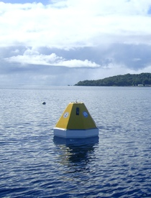
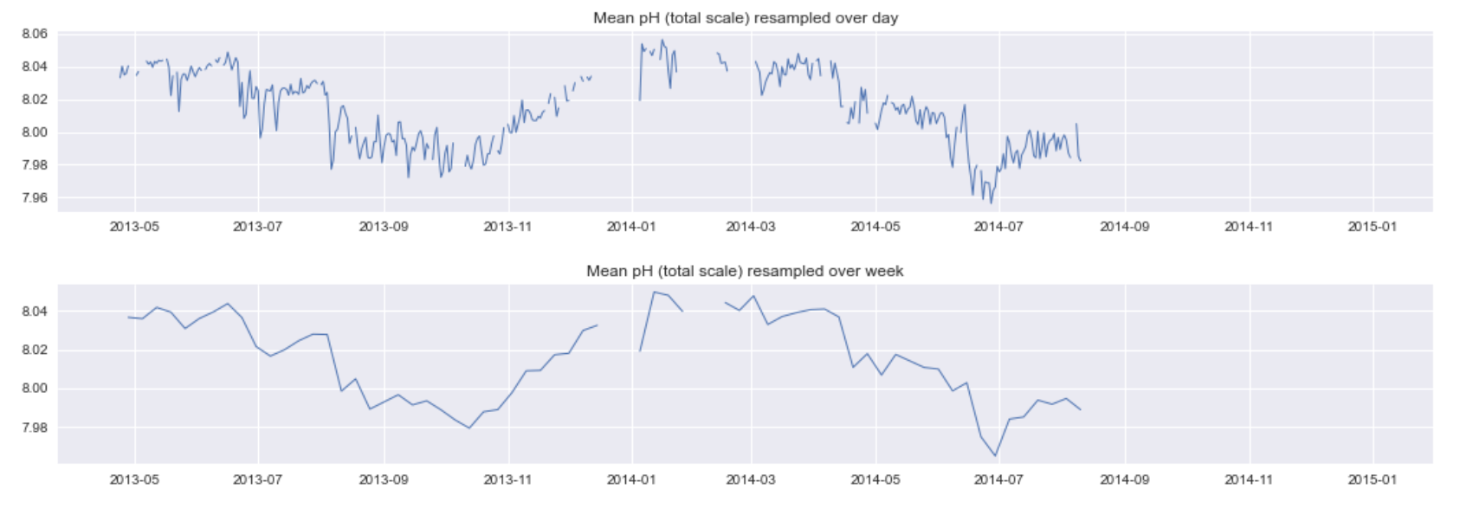
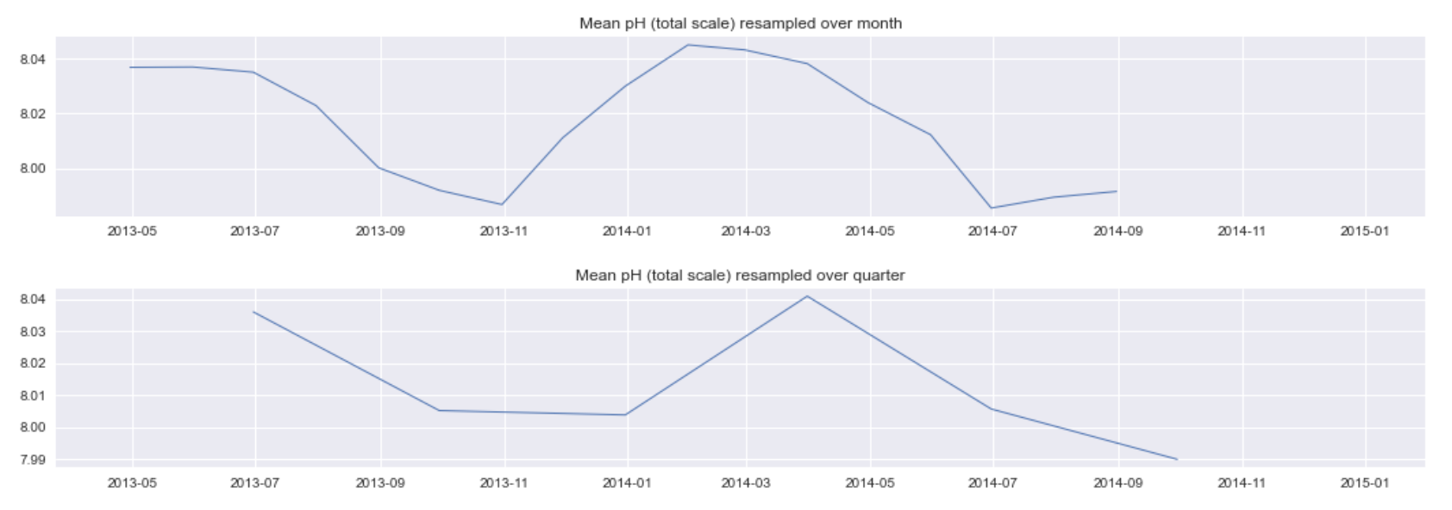
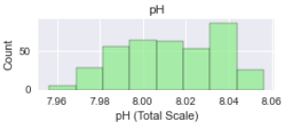

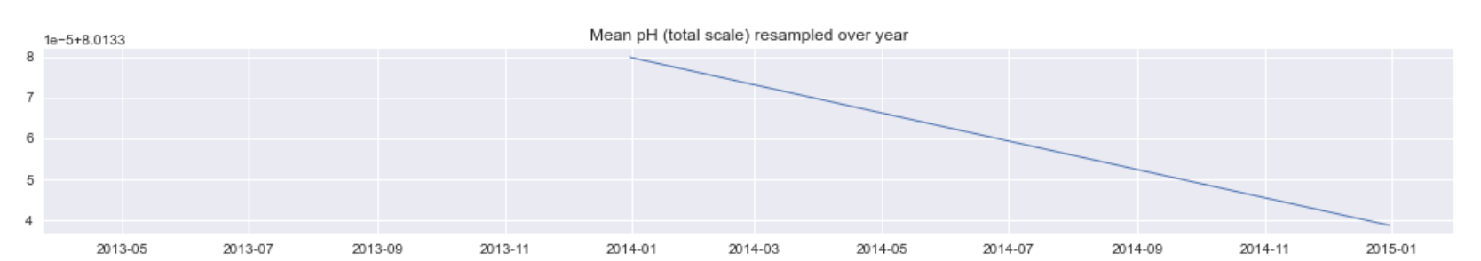
Project Data
NOAA Mooring Chuuk K1
(7.46˚N, 151.90˚E)
Target Value: pH
379 observations over 16 months
Hourly data averaged by day
No outliers as indicated by boxplot
Approximately normal distribution
Seasonal trends of increasing and decreasing pH
Minimum pH 7.95
Maximum pH 8.05
Notes:
The data comes from a morning that is managed by the National Oceanic and atmospheric administration called Chuck K1 . This morning is located in chuuk lagoon which resides in Micronesia western Pacific. The lagoon is a semi enclosed circular oceanic atoll and it happens to be one of the largest in the world. The target feature of this data is pH however other features are also included in this data set. This data set includes 379 observations over 16 months. Those observations were averaged from hourly data to daily data. A boxplot and histogram or created for this data both indicating that there is nearly normal data with no outliers. The minimum pH currently is 7.95 with a maximum of 8.05. The line plots of average per day week month quarter in year feature seasonal trends that increase pH through the summer and decrease pH through the winter. This is due to the ability of water to absorb carbon dioxide based on the temperature. Cooler water has the ability to absorb more carbon dioxide which results in a lower pH. The summer months feature warmer water which is not able to absorb as much carbon dioxide as cooler water which is why the pH is much higher in the summer then the winter. The last line plot featuring the overall trend is a highly negative trend meaning that throughout the entire year DPH was recorded lower on average then previous years.

Slide 6
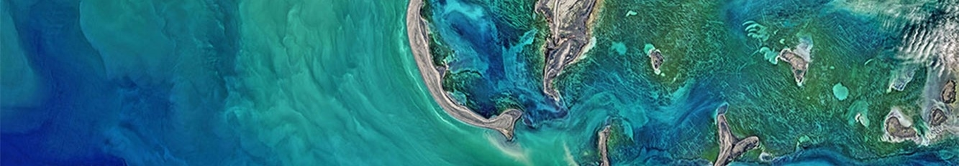
Model One
The first model chosen was a vector autoregression
This is a time series forecasting model. Within the parameters of this model, the features must be stationary. With the first test of the augmented Dickey-Fuller test, nearly all features were deemed non-stationary. The difference transformation was applied and the test run again. The results came back with stationary features. A lag order of 3 was then chosen based on an AIC test.

Slide 7
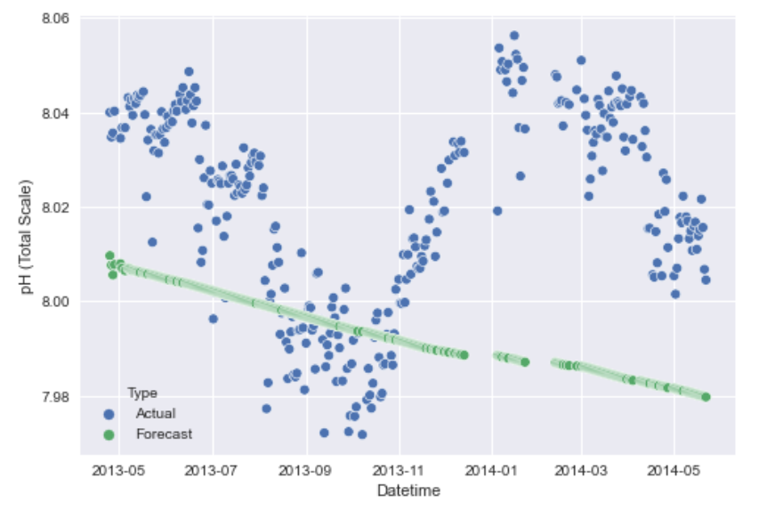
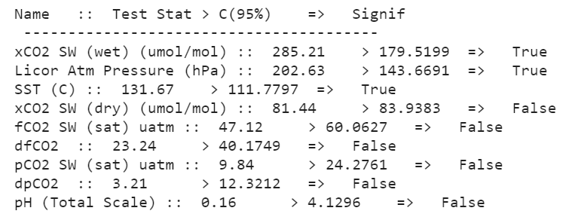
First Model
Since the model predicted all features, not enough attention on just pH.
Further transformations may improve the model slightly. Other types of models were investigated.
Vector Autoregression
Multivariate predictions
Using cointegration
Predicts all features
Johanson’s Cointegration Test Results
The failure of this model could be as a result of not enough features having a true cointegration result.

Slide 8
Model Two
The second model chosen was a Long Short Term Memory Network
This is a recurrent neural network. The requirements of this model include an arbitrary duration, resistant to noise, and trainable parameters. This network typically uses context to be able to make predictions.

Slide 9
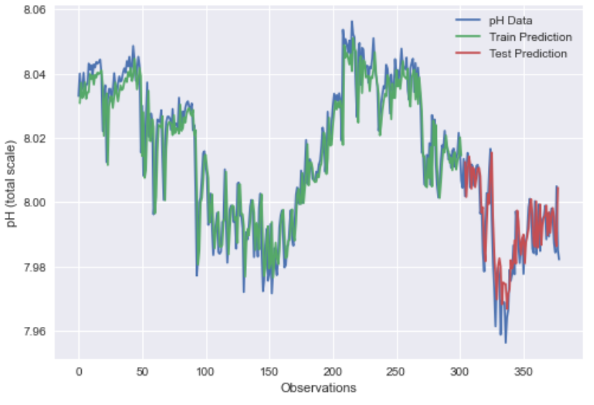
Second Model
Long Short Term
Memory Network
Singular prediction
Time duration
Metric | Training | Testing
RMSE | 0.01 | 0.01
R2 | 0.92 | 0.77
Visually, this model has higher accuracy than the VAR model.
The model accurately predicted the training set 92% of the time.
The model accuracy predicted the testing set 77% of the time

Slide 10
Future Use
See changes in trend made through heavier use of green energy and the reduction of carbon dioxide emissions
Continue to update model with new data to further fine tune model with current trend.
Improve research by constantly following changes in trend to better assume future pH values in research trials.
10
Notes:
The best course of action for this model would be to continue to update the model with data as it becomes available daily this way the model is the most accurate in predicting future pH as well as the future trend this can help companies and researchers alike in understanding how current actions are affecting future pH . Businesses are able to see how using greener energy and lowering their carbon emissions reflect in reducing the negative trend NPH. researchers are able to use this updated model to be able to continue to perform the most accurate research reflecting the most realistic future pH as time changes the trend. With updates to the model trends may change or improve which researchers can use 2 test using the most accurate trials.in addition with the hope that the rapid decline of pH improves this model could provide media a clear way to inspire those who watch chill take actions into their own hands and reduce their carbon emissions or inspire them to go visit a beach on vacation or by just stepping outside their door.

